Slide 1



Walmart Sales Data analysis using MySQL
Present by:CH.Krishna Vamsi BATCH NAME-MIP-DA-13

Slide 2
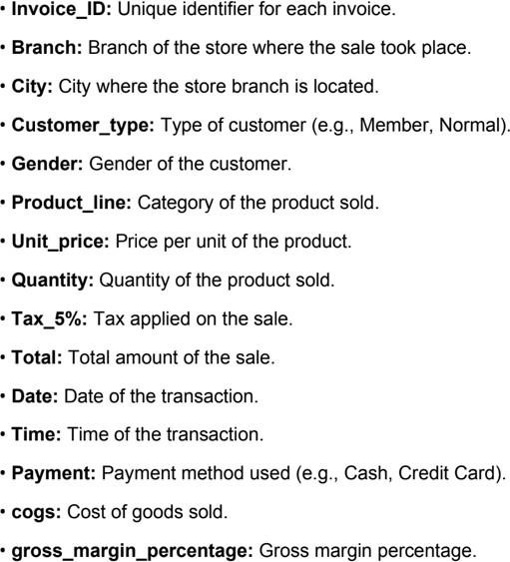

DATA SETS

Slide 3

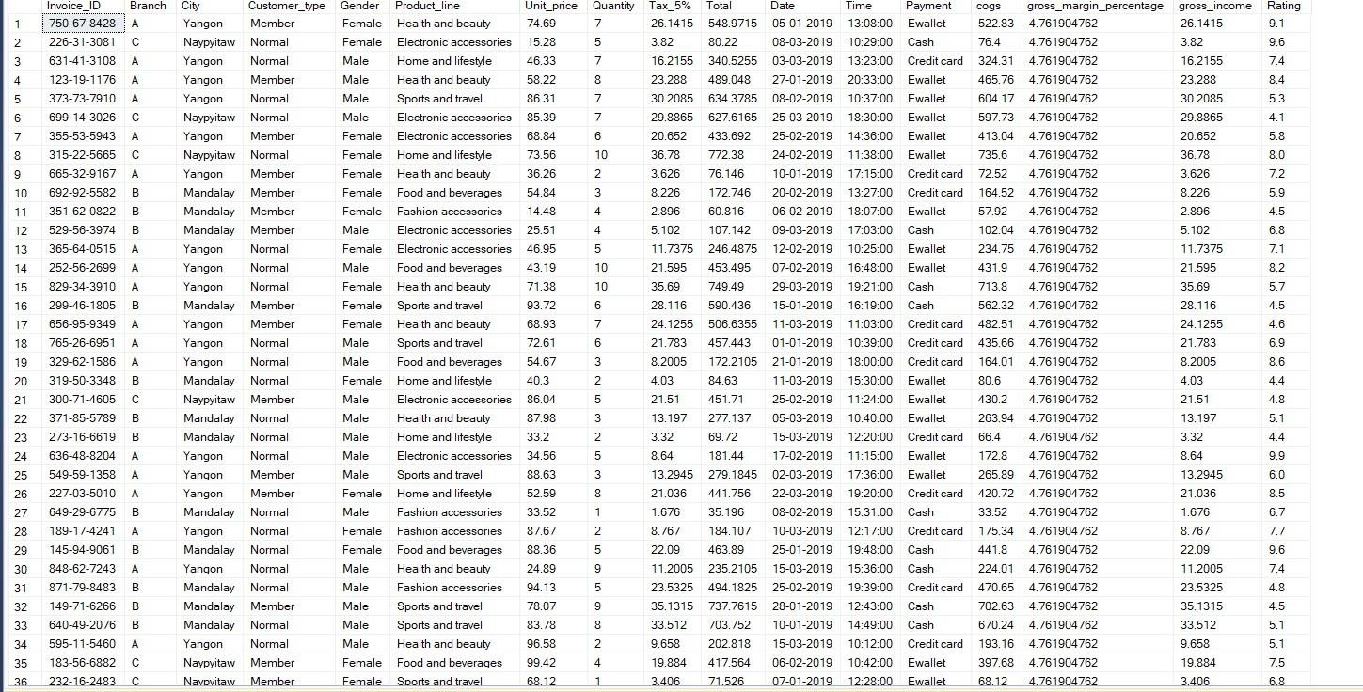

Slide 4
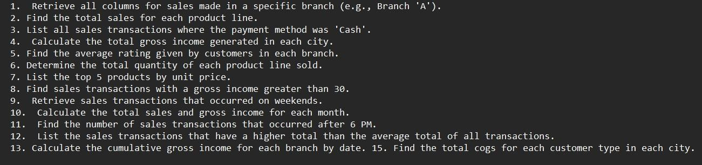

Slide 5
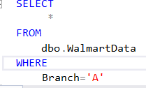
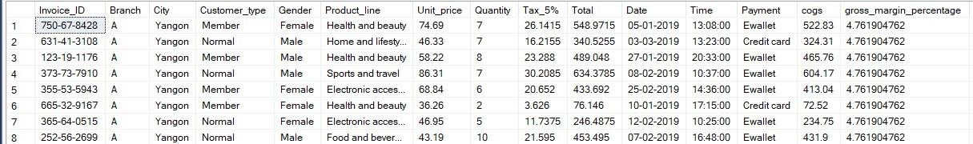
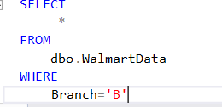
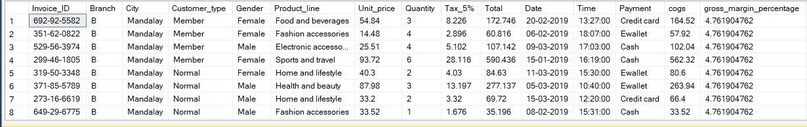
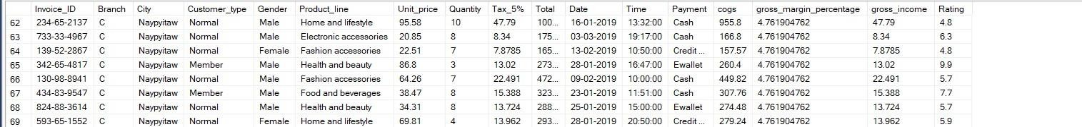
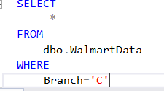
1. Retrieve all columns for sales made in a specific branch (e.g., Branch 'A').

Slide 6
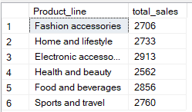
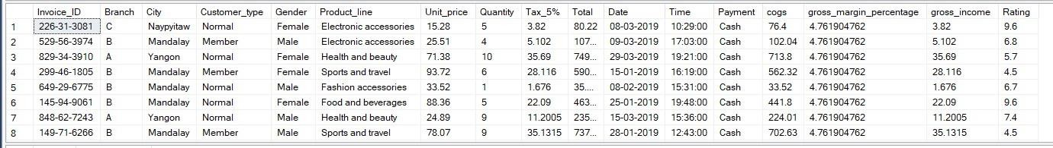

2. Find the total sales for each product line.
3. List all sales transactions where the payment method was 'Cash'.

Slide 7
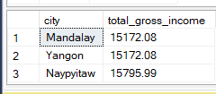
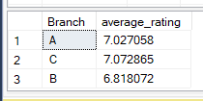
4. Calculate the total gross income generated in each city.
5. Find the average rating given by customers in each branch.

Slide 8
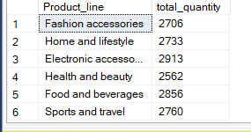

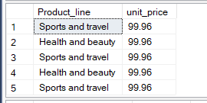
6. Determine the total quantity of each product line sold.
7. List the top 5 products by unit price.

Slide 9
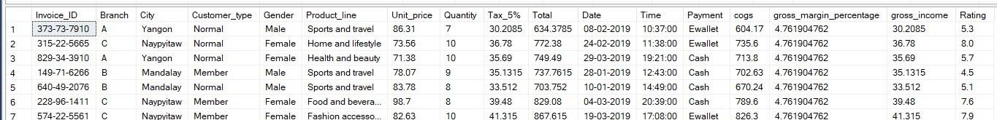
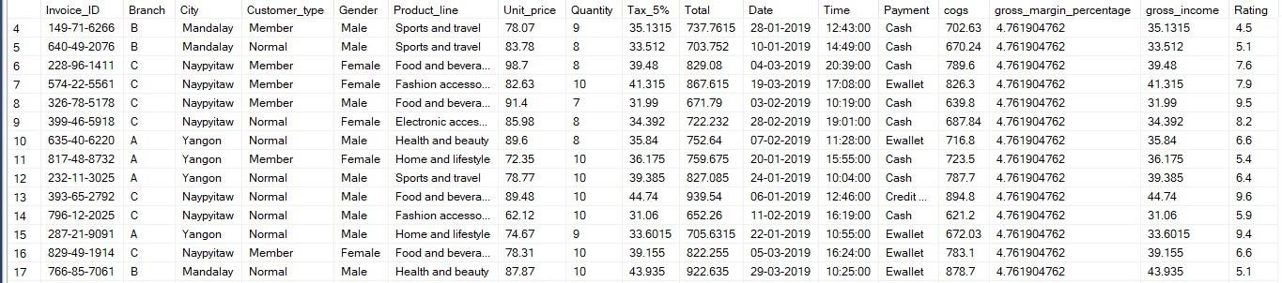
8. Find sales transactions with a gross income greater than 30.
9. Retrieve sales transactions that occurred on weekends.

Slide 10
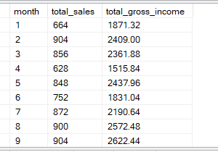

10. Calculate the total sales and gross income for each month.
11. Find the number of sales transactions that occurred after 6 PM.

Slide 11
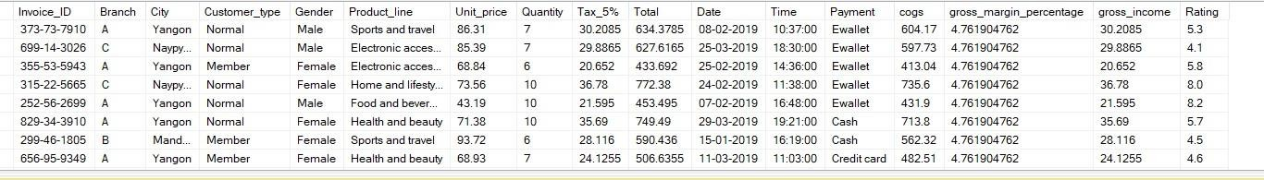
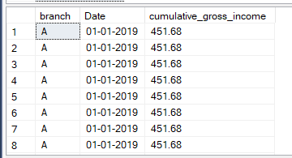
12. List the sales transactions that have a higher total than the average total of all transactions.
13. Calculate the cumulative gross income for each branch by date.

Slide 12
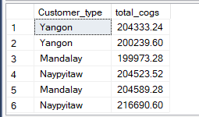
14. Find the total cogs for each customer type in each city.

Slide 13
Insights
1.Number of transactions occurred after 6PM =1116. 2.Naypyitaw city has highest total gross income.
3.Branch B has highest average rating by Customers. 4.Electronic accessories (Product line) has highest total sales.
5.Naypyitaw (Customer type) has highest total cogs.

Slide 14
THANK YOU

